Slide 1
Technical Interaction Design
What is it?
[...Bjørn H. Westh] TID 30-8-2022, ITU CPH

Slide 2
Buchanan’s 4 orders of design
1: Signs
2: Things
3: Interactions
4: Systems
Graphics
Symbols & Logos
Text
Colour
Products
Objects
Calculations
Information
Actions
Interfaces
Activities
Conveyance & Education
Environments
Universities
Governments
Companies
Society
Tangible & visible
Abstract & invisible
[...Bjørn H. Westh] TID 30-8-2022, ITU CPH

Slide 3
The Course
[...Bjørn H. Westh] TID 30-8-2022, ITU CPH

Slide 4
The Format
of the course
[...Bjørn H. Westh] TID 30-8-2022, ITU CPH

Slide 5
course/format
Lectures
Exercises
Exam Project (groups)
Presentations
[...Bjørn H. Westh] TID 30-8-2022, ITU CPH

Slide 6
course/format
Lectures
Exercises
Exam Project (groups)
Presentations
1-2 each week
15-30 minutes each
Will be recorded
1-3 each week
15-30 minutes each
Will be recorded
[...Bjørn H. Westh] TID 30-8-2022, ITU CPH

Slide 7
course/format
Lectures
Exercises
Exam Project (groups)
Presentations
Directly related to lecture
Type varies
Not part of exam project
Directly related to lecture
Type varies
Not part of exam project
[...Bjørn H. Westh] TID 30-8-2022, ITU CPH

Slide 8
course/format
Lectures
Exercises
Exam Project (groups)
Presentations
Groups of 3-4
Exceptions can occur, but need good
reason
Written report + GitHub source code
[...Bjørn H. Westh] TID 30-8-2022, ITU CPH

Slide 9
course/format
Lectures
Exercises
Exam Project (groups)
Presentations
Typically: 1 Group on 1 group
1 presents -> other gives feedback
Swap roles and repeat
[...Bjørn H. Westh] TID 30-8-2022, ITU CPH

Slide 10
course/format
Lectures
Exercises
Exam Project (groups)
Presentations
Bonus “lectures” (live-coding etc)
Subject will depend on what is
needed
3 planned - revise as we go along
[...Bjørn H. Westh] TID 30-8-2022, ITU CPH

Slide 11
The Deliverables
[...Bjørn H. Westh] TID 30-8-2022, ITU CPH

Slide 12
course/deliverables
A portfolio
Research
Lo-Fi prototype
Hi-Fi prototype
Sprint 1-3 reports
Source code on GitHub
[...Bjørn H. Westh] TID 30-8-2022, ITU CPH

Slide 13
course/deliverables
A portfolio
Research
Lo-Fi prototype
Hi-Fi prototype
Sprint 1-3 reports
Source code on GitHub
What you did (Short description)
Why you did it (theories and principles)
What you learned (reflections)
What you did (Short description)
Why you did it (theories and principles)
What you learned (reflections)
[...Bjørn H. Westh] TID 30-8-2022, ITU CPH

Slide 14
course/deliverables
A portfolio
Research
Lo-Fi prototype
Hi-Fi prototype
Sprint 1-3 reports
Source code on GitHub
Empathising with users (e.g. personas, interviews, etc)
Defining the problem domain (e.g. The four Ws, The five whys)
Empathising with users (e.g. interviews)
Defining the problem domain (e.g. personas)
[...Bjørn H. Westh] TID 30-8-2022, ITU CPH

Slide 15
course/deliverables
A portfolio
Research
Lo-Fi prototype
Hi-Fi prototype
Sprint 1-3 reports
Source code on GitHub
Wireframes
User testing
More wireframes
Wireframes
User testing
More wireframes
[...Bjørn H. Westh] TID 30-8-2022, ITU CPH

Slide 16
course/deliverables
A portfolio
Research
Lo-Fi prototype
Hi-Fi prototype
Sprint 1-3 reports
Source code on GitHub
Figma
User testing
More Figma
Figma
User testing
More Figma
[...Bjørn H. Westh] TID 30-8-2022, ITU CPH

Slide 17
course/deliverables
A portfolio
Research
Lo-Fi prototype
Hi-Fi prototype
Sprint 1-3 reports
Source code on GitHub
1-3 Examples (of what you did and why)
Refactorings (What was wrong and how you corrected it)
1-3 Examples (of what you did and why)
Refactorings (What was wrong and how you corrected it)
[...Bjørn H. Westh] TID 30-8-2022, ITU CPH

Slide 18




course/deliverables
A portfolio
Research
Lo-Fi prototype
Hi-Fi prototype
Sprint 1-3 reports
Source code on GitHub
[...Bjørn H. Westh] TID 30-8-2022, ITU CPH

Slide 19
The Evaluation
[...Bjørn H. Westh] TID 30-8-2022, ITU CPH

Slide 20
course/evaluation
The course
The exercises
The assignments
[...Bjørn H. Westh] TID 30-8-2022, ITU CPH

Slide 21
course/evaluation
The course
The exercises
The assignments
Formative
Open door policy
2 x discussions during course
Summative
Official course evaluation
Formative
Open door policy
2 x discussions during course
Summative
Official course evaluation
[...Bjørn H. Westh] TID 30-8-2022, ITU CPH

Slide 22
course/evaluation
The course
The exercises
The assignments
Formative
N/A
Summative
Group-to-group presentations
Plenum discussion
Formative
N/A
Summative
Group-to-group presentations
Plenum discussion
[...Bjørn H. Westh] TID 30-8-2022, ITU CPH

Slide 23
course/evaluation
The course
The exercises
The assignments
Formative
Group-to-group presentation
Teaching staff feedback
Summative
Exam
Formative
Group-to-group presentation
Feedback from teaching staff
Summative
Exam
[...Bjørn H. Westh] TID 30-8-2022, ITU CPH

Slide 24
The ILOs
(Intended Learning Outcomes)

Slide 25
course/ilos
After the course, the student should be able to:
Explain and compare interaction design processes and principles.
Understand and apply usability principles to user interface design.
Create, evaluate, and critique the design of an interactive web application.
Compose a technical implementation of a design using a frontend framework.
Reflect on and apply source code usability principles in order to support maintainability.
Design a domain model and create an implementation using a low-code backend platform.
[...Bjørn H. Westh] TID 30-8-2022, ITU CPH

Slide 26
course/ilos
After the course, the student should be able to:
Explain and compare interaction design processes and principles.
Understand and apply usability principles to user interface design.
Create, evaluate, and critique the design of an interactive web application.
Compose a technical implementation of a design using a frontend framework.
Reflect on and apply source code usability principles in order to support maintainability.
Design a domain model and create an implementation using a low-code backend platform.
SOLO 4
SOLO 4
SOLO 5
SOLO 5
SOLO 5
SOLO 4
[...Bjørn H. Westh] TID 30-8-2022, ITU CPH

Slide 27
course/ilos
SOLO 1
SOLO 2
SOLO 3
SOLO 4
SOLO 5
Prestructural
At the prestructural stage, students don’t have any understanding of the topic. This may be because they’ve never encountered it before!
Unistructural
A student with unistructural understanding tends to understand only one or two elements of the task, but not the whole.
Multistructural
At the multistructural level, the student has begun to acquire a lot knowledge, but can’t put it together yet.
Relational
The relational stage is the first that shows deep qualitative understanding of a topic and more complex thinking skills.
Extended Abstract
At the extended abstract stage, students have a sophisticated understanding of the topic and can apply it in various contexts.
[...Bjørn H. Westh] TID 30-8-2022, ITU CPH

Slide 28
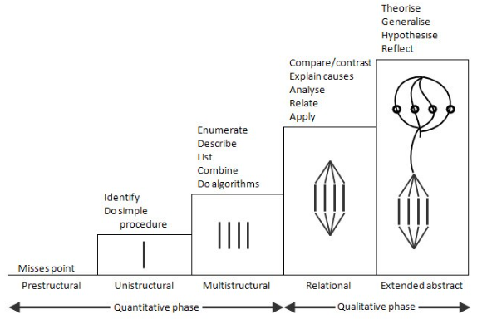
course/ilos
SOLO 5
SOLO 4
SOLO 3
SOLO 2
SOLO 1
[...Bjørn H. Westh] TID 30-8-2022, ITU CPH

Slide 29
course/ilos
After the course, the student should be able to:
Explain and compare interaction design processes and principles.
Understand and apply usability principles to user interface design.
Create, evaluate, and critique the design and of an interactive web application.
Compose a technical implementation of a design using a frontend framework.
Reflect on and apply source code usability principles in order to support maintainability.
Design a domain model and create an implementation using a low-code backend platform.
SOLO 4
SOLO 4
SOLO 5
SOLO 5
SOLO 5
SOLO 4
[...Bjørn H. Westh] TID 30-8-2022, ITU CPH

Slide 30
The Group Formation
[...Bjørn H. Westh] TID 30-8-2022, ITU CPH

Slide 31
course/group formation
Things to know
Mixed-skill groups === high risk && high reward
[...Bjørn H. Westh] TID 30-8-2022, ITU CPH

Slide 32
course/group formation
Things to know
Mixed-skill groups === high risk && high reward
Men tend to do technical tasks*. Women tend to do non-technical**
*backend, testing, controller **research, design, correcting report
[...Bjørn H. Westh] TID 30-8-2022, ITU CPH

Slide 33
The Project
[...Bjørn H. Westh] TID 30-8-2022, ITU CPH

Slide 34
course/project
Description
Functional Requirements
The …rest
A live chat application
[...Bjørn H. Westh] TID 30-8-2022, ITU CPH

Slide 35
course/project
Description
Functional Requirements
The …rest
Required Software Requirements
Login Requirements
The system must work with a database.
The system must allow users to register in the system.
The system must allow users to sign in to an existing account.
The system must allow users to sign out.
Messaging Requirements
The system must allow users to send a new text message to another single user.
The system must allow users to send a new text message to a group of users.
The system must allow users to send a text message in a current thread.
Other Requirements
The system must allow users to see a list of previous message threads.
[...Bjørn H. Westh] TID 30-8-2022, ITU CPH

Slide 36
course/project
Description
Functional Requirements
The …rest
Users?
Other functional requirements?
Layout & Graphic design?
Mobile or desktop?
[...Bjørn H. Westh] TID 30-8-2022, ITU CPH

Slide 37
course/project
Description
Functional Requirements
The …rest
Users?
Other functional requirements?
Layout & Graphic design?
Mobile or desktop?
Yes!
[...Bjørn H. Westh] TID 30-8-2022, ITU CPH

Slide 38
course/project
Description
Functional Requirements
The …rest
Users?
Other functional requirements?
Layout & Graphic design?
Mobile or desktop?
Yes!
(maybe?)
[...Bjørn H. Westh] TID 30-8-2022, ITU CPH

Slide 39
The Recommended Readings
(Which are all very optional and for that “I wanna learn more” feeling)
[...Bjørn H. Westh] TID 30-8-2022, ITU CPH

Slide 40

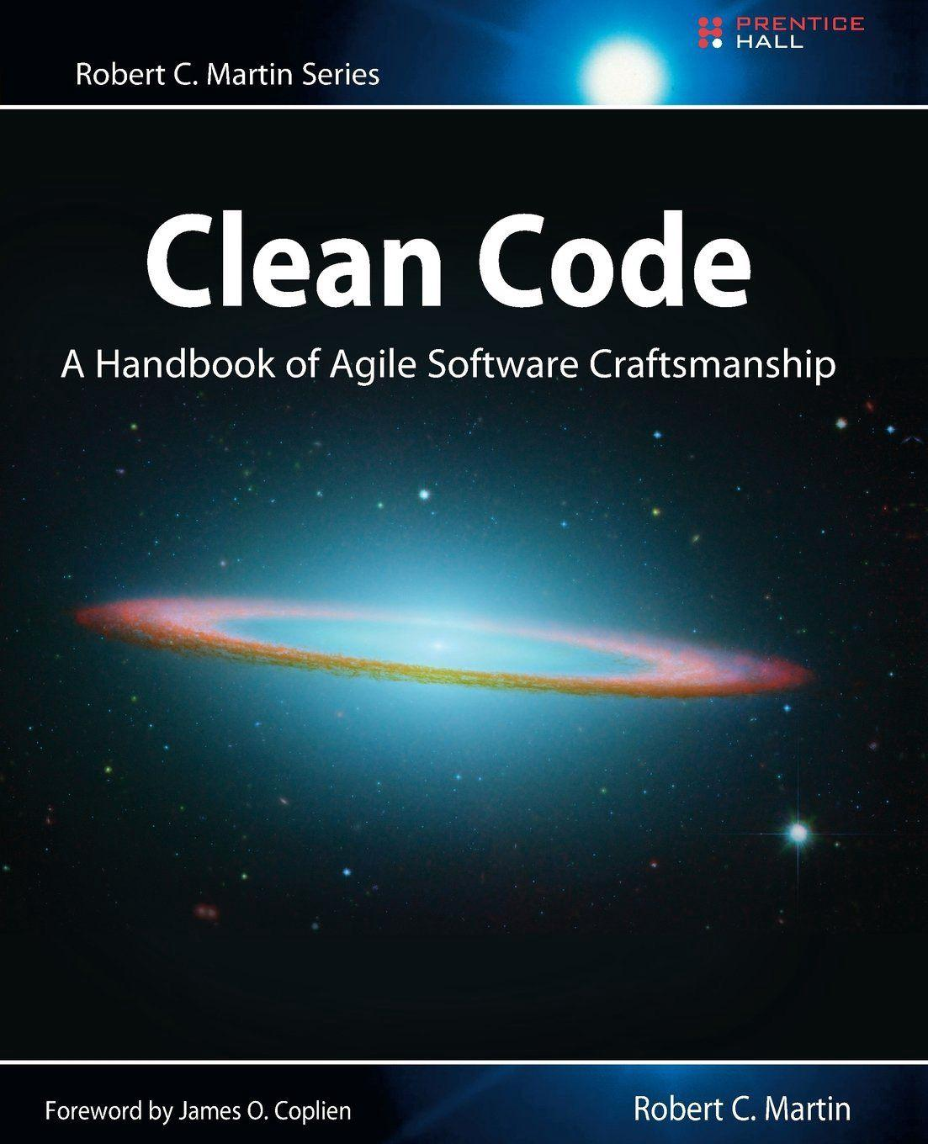
course/recommended readings
[...Bjørn H. Westh] TID 30-8-2022, ITU CPH

Slide 41
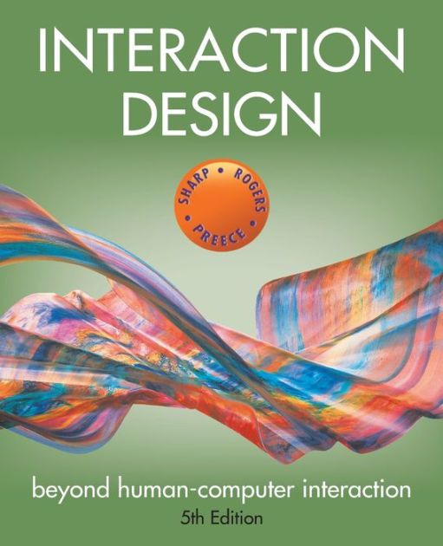

course/recommended readings
[...Bjørn H. Westh] TID 30-8-2022, ITU CPH

Slide 42



course/recommended readings
[...Bjørn H. Westh] TID 30-8-2022, ITU CPH

